Slide 1
Navigation Deck for 360 Review Process

Slide 2
Employee Related Tasks
011 Presentation title

Slide 3
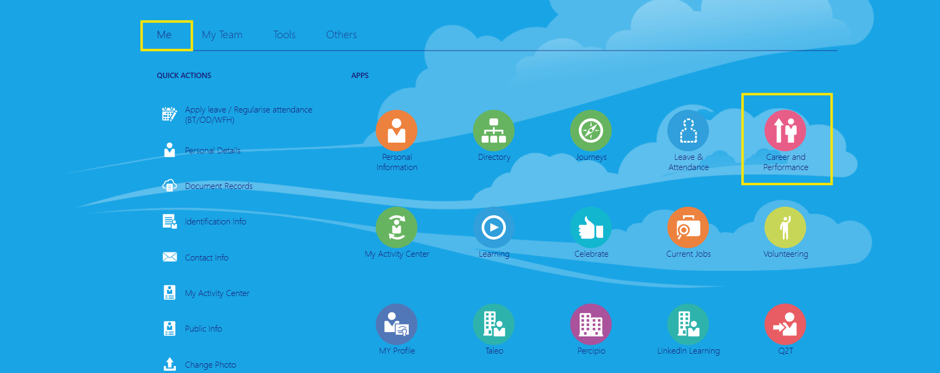
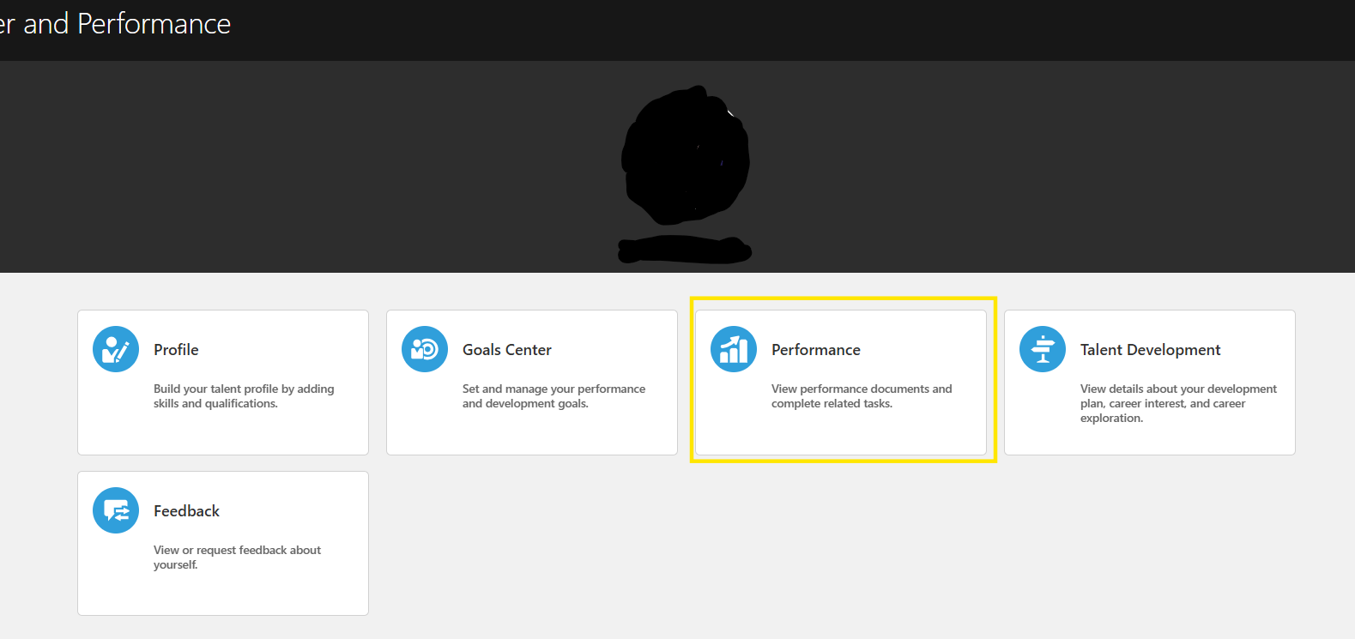
Self-Evaluation
Step 1 : Login into the system and go to Me > Career and Performance > Performance

Slide 4
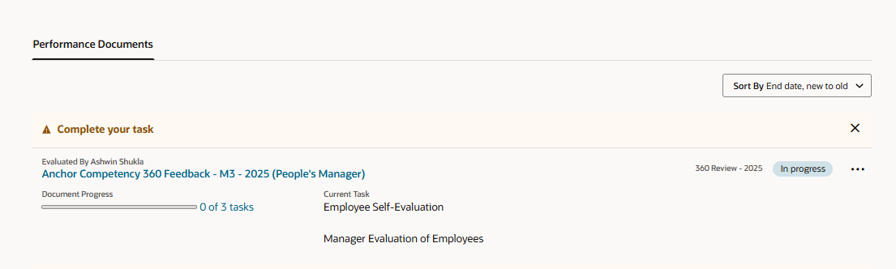
Self-Evaluation
Step 2 : Click on the 360 Evaluation document

Slide 5
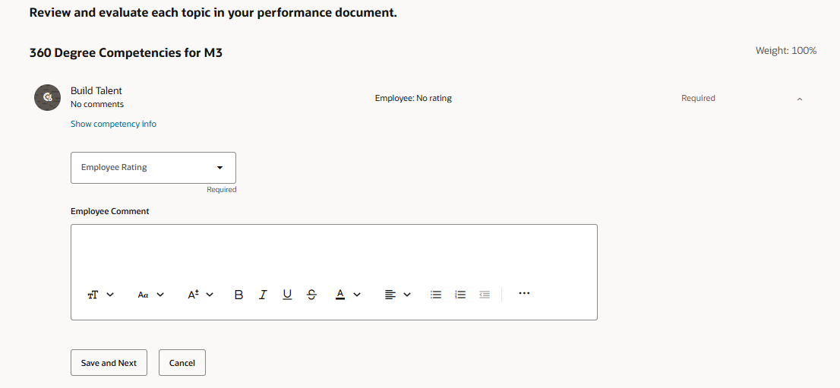
Self-Evaluation
Step 3 : Go to the Competency section and give rating and comments in the competency items and click ‘Save and Next’
Repeat the same steps for all the competency items

Slide 6
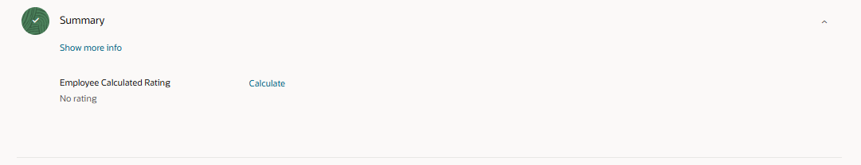
Self-Evaluation
Step 4 : In the summary section click on ‘Calculate’ to find calculated rating and provide summary rating.

Slide 7
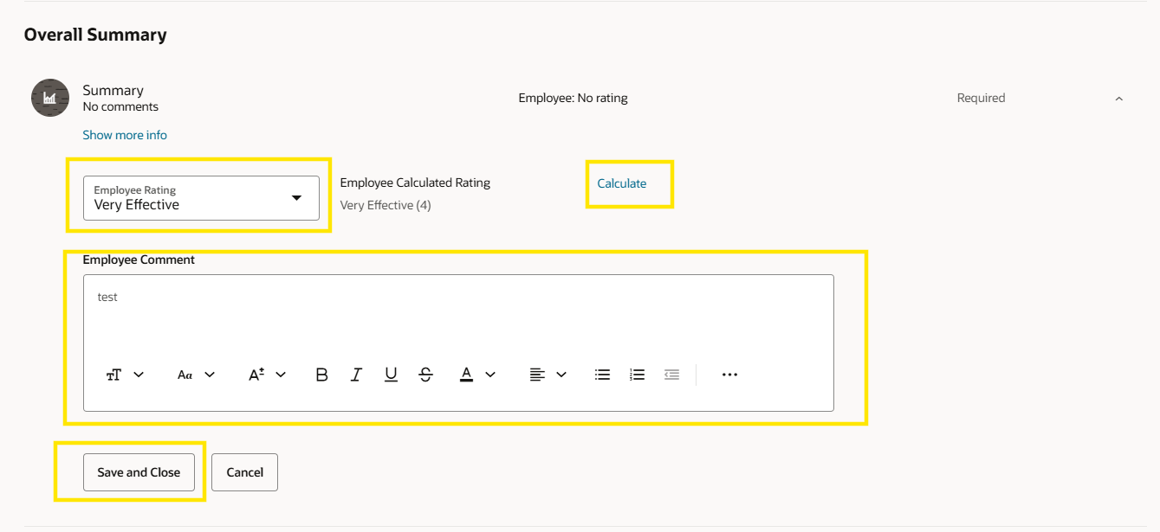
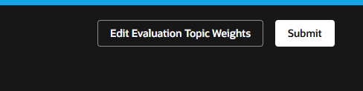
Self-Evaluation
Step 5 :
Scroll down to the ‘Overall Summary’ section.
Provide the final rating and comments and click ‘Save and Close’
After providing all the ratings and comments click on ‘Submit’

Slide 8
Participant Related Tasks
011 Presentation title

Slide 9
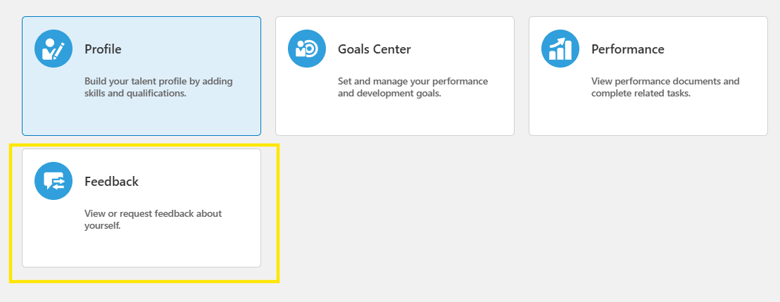
Participant Feedback
Step 1 :
As Participant log in into the system.
Me > Career and Performance > Feedback

Slide 10
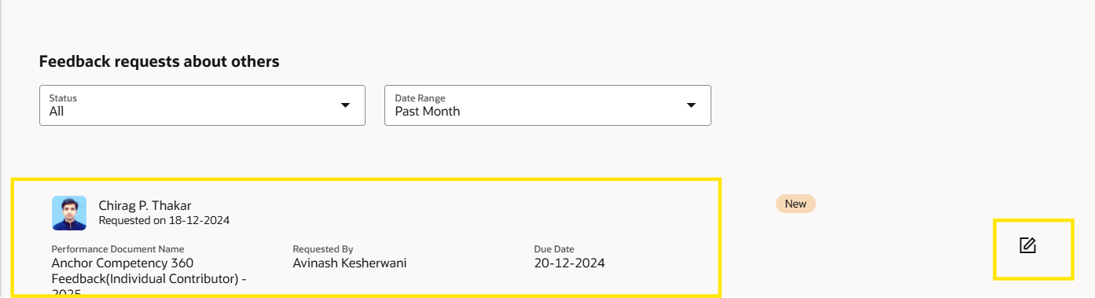
Participant Feedback
Step 2 :
As the feedback requests will appear in the Feedback Requests about others section.
Click on the edit icon right next to the document to provide feedback.

Slide 11
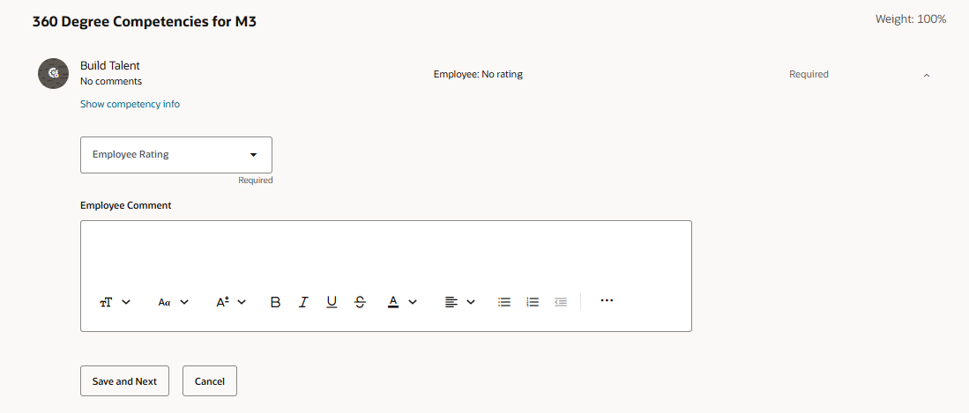
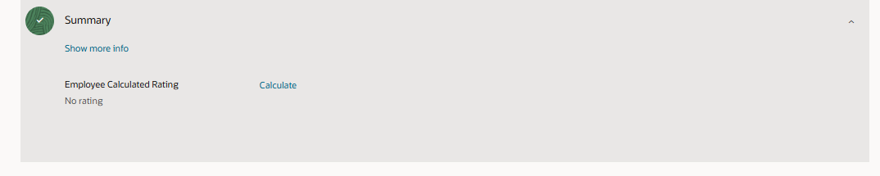
Participant Feedback
Step 3 :
Go to the Competency section and give rating and comments in the competency items and click ‘Save and Next’
Repeat the same steps for all the competency items

Slide 12
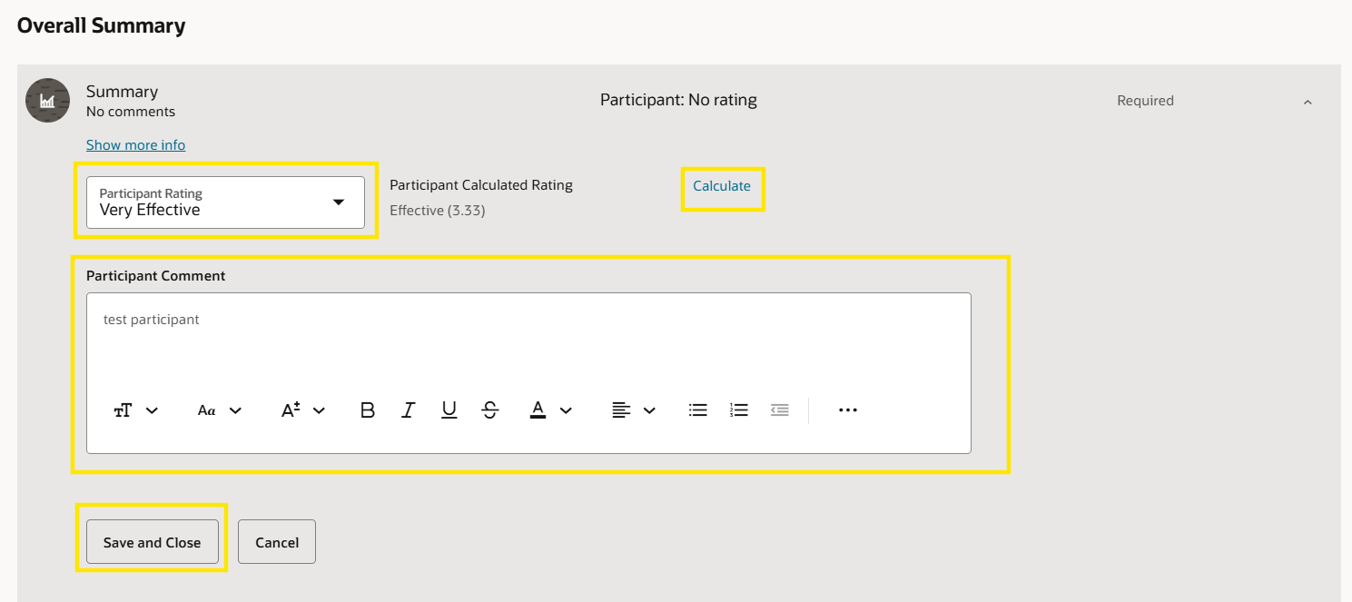
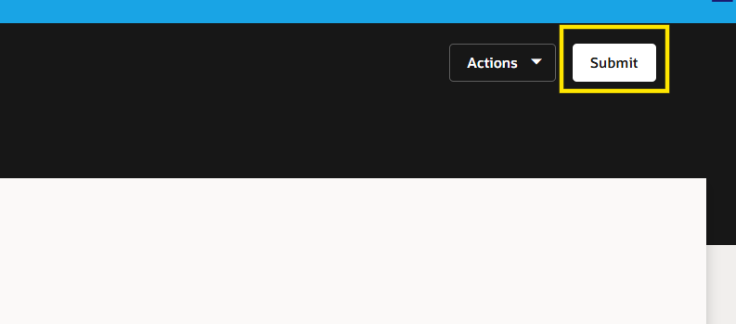
Participant Feedback
Step 4 :
Scroll down to the ‘Overall Summary’ section and click calculate to find calculated rating
Provide the final rating and comments and click ‘Save and Close’
After providing all the ratings and comments click on ‘Submit’

Slide 13
Manager Related Tasks
011 Presentation title

Slide 14
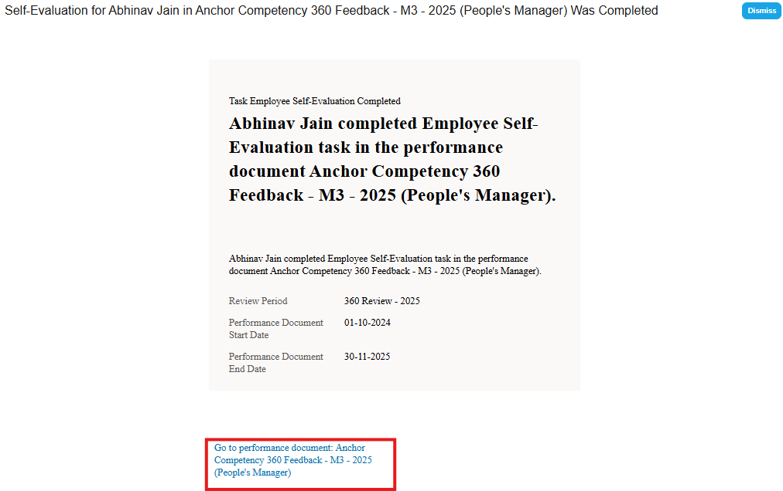

Once the employee submits the document notification will trigger to the line manager, Manager will click on the link in the notification to go to the document or through below path
Manager Feedback

Slide 15
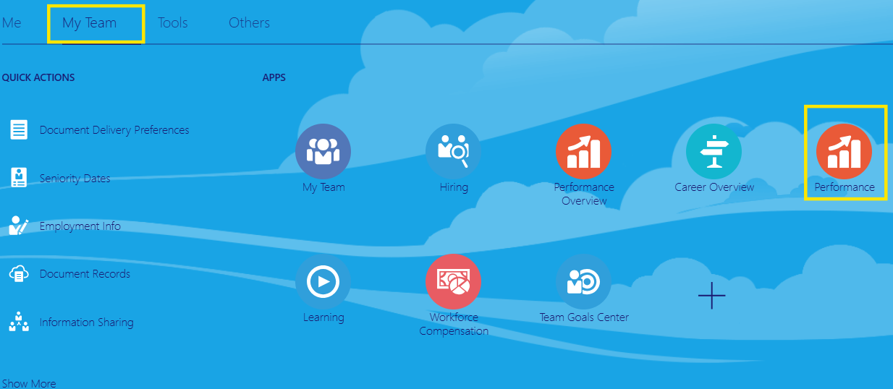
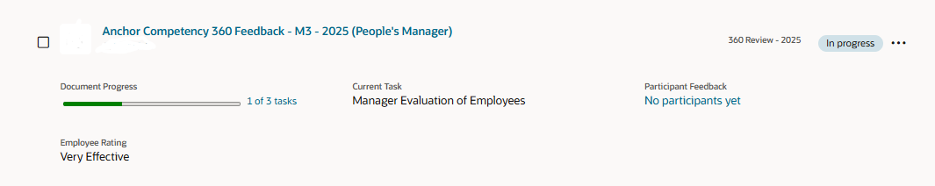
The Document can be opened via the path : My team > Performance > Click on the 360 document name
Manager Feedback

Slide 16
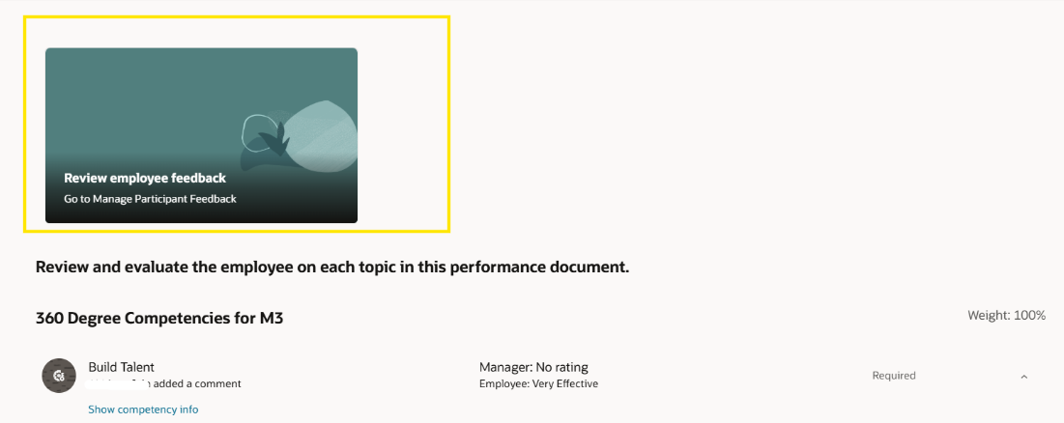
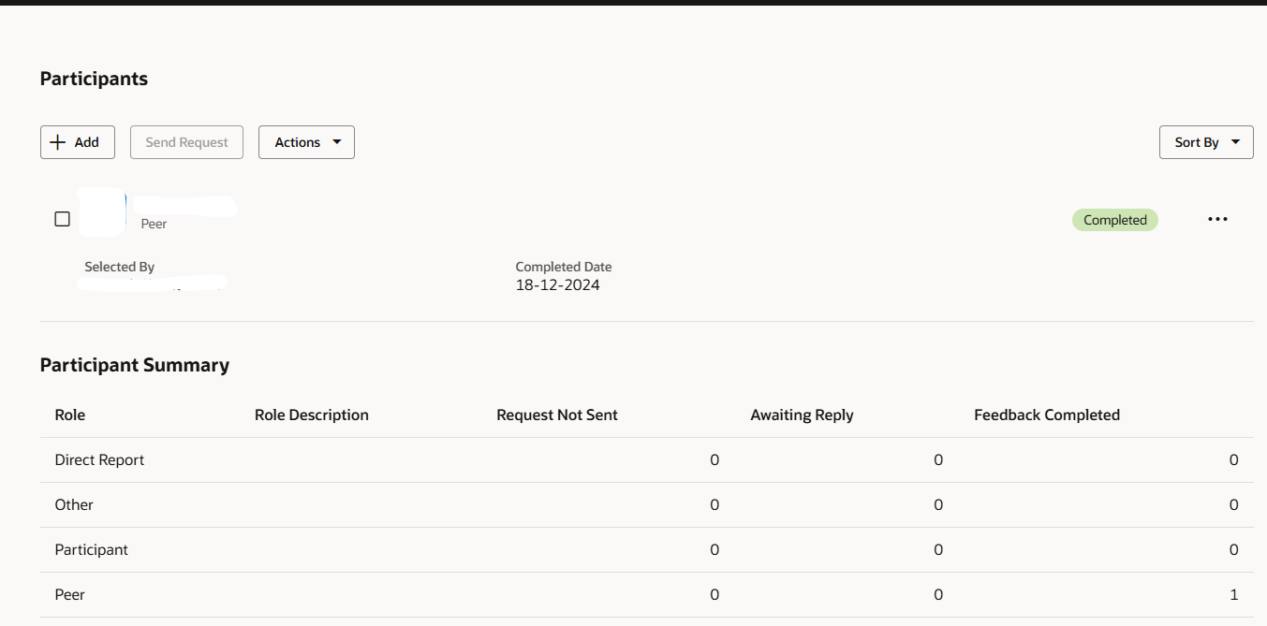
Click on the Participant Feedback card to go to the Manage Participants.
Manager Feedback

Slide 17
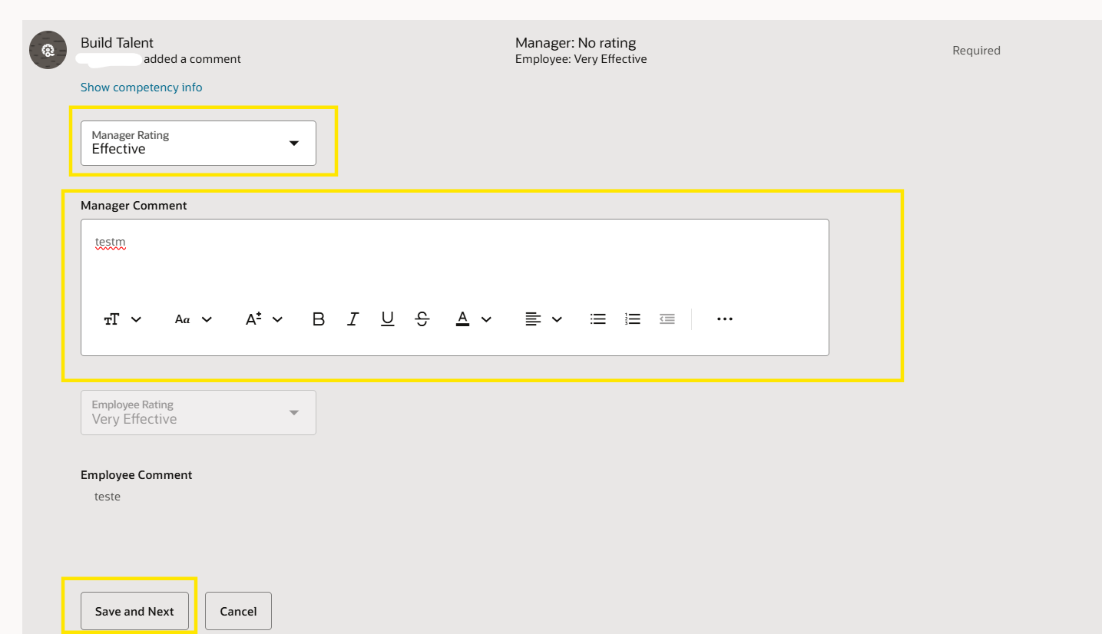
Go to the Competency section and give rating and comments in the competency items and click ‘Save and Next’
Repeat the same steps for all the competency items
Manager Feedback

Slide 18
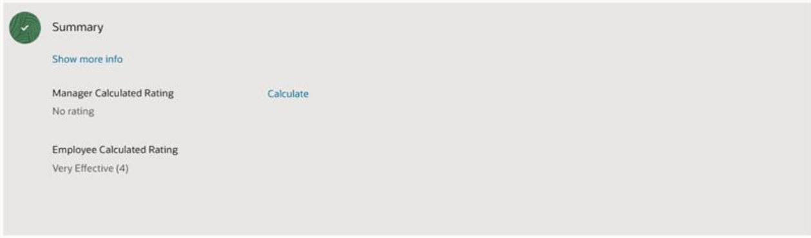
In the summary section click on ‘Calculate’ to find calculated rating and provide summary rating.
Manager Feedback

Slide 19
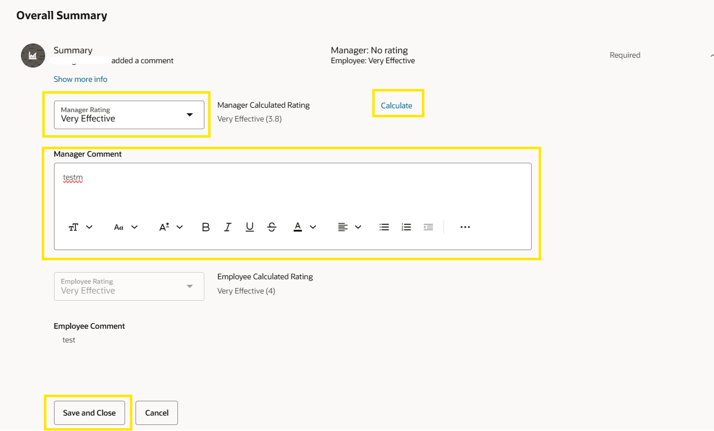
Scroll down to the ‘Overall Summary’ section.
Provide the final rating and comments and click ‘Save and Close’
After providing all the ratings and comments click on ‘Submit’
Manager Feedback

